Slide 1

BY
RASHMI PRADEEP

Slide 2
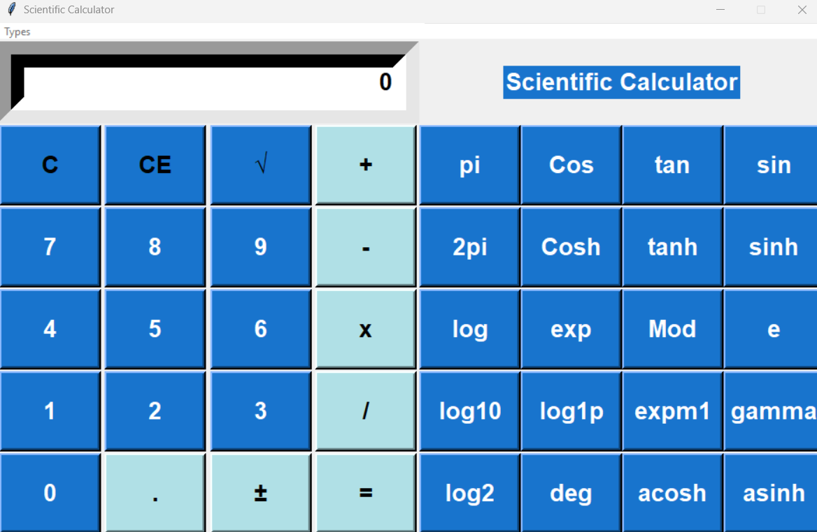
Scientific calculator

Slide 3
Introduction & Objectives:
To create a GUI based scientific calculator using python, tkinter libraries in VSC
What is a Scientific Calculator?
A scientific calculator is a type of electronic calculator, usually but not
always handheld, designed to calculate problems in science,
engineering, and mathematics.
The python calculator was implemented using tkinter to make the calculation of mathematical functions easier. The application consists of scientific and standard functions.
What is Python
Python is a high-level, interpreted, interactive and object-oriented scripting language.
Python's bulk of the library is very portable and cross-platform compatible
Python supports GUI applications that can be created and ported to many system calls, libraries and windows systems

Slide 4
Visual Studio Code
Visual Studio Code is a free source code editor, made by Microsoft for Windows, Linux and macOS. Features include support for debugging, syntax highlighting, intelligent code completion, snippets, code refactoring, and embedded Git.
Users can change the theme, keyboard shortcuts, preferences, andinstall extensions that add additional functionality.
The python extension in Visual Studio Code makes it an excellent video editor.

Slide 5
Tkinter Programming
Tkinter is the standard GUI library for Python.
Python when combined with Tkinter provides a fast and easy way to create GUI applications.
Tkinter provides a powerful object-oriented interface to the Tk GUI toolkit.
All you need to do is perform the following steps −
1.Import the Tkinter module.
2.Create the GUI application main window.
3.Add one or more of the above-mentioned widgets to the GUI application.
4.Enter the main event loop to take action against each event triggered by theuser.

Slide 6
Key Implementation Steps
GUI Layout
Creating the main window: root = Tk()
Designing buttons
Displaying output: Using an Entry widget to show calculations and results.
Event handling: How to capture button clicks.
Storing input: Building the expression string as the user types.
Performing Calculations:
eval() function: for evaluating mathematical expressions.
Integrating math functions: How to call functions like math.sin() within the calculation logic.

Slide 7
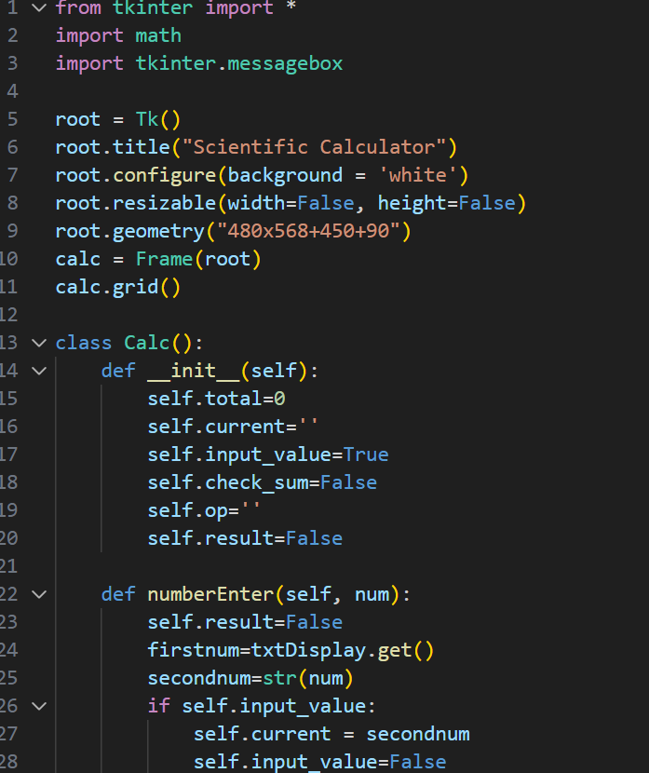
4. Code Snippets (Illustrative Examples)

Slide 8
Summary:
The proposed system is error free.
Trivial concepts of Python language are implemented to build a user friendly application.
Potential Improvements:
Error handling for invalid inputs.
Adding more advanced scientific functions.
Implementing memory functions.

Slide 9
Challenges Faced While Creating the Scientific Calculator
Designing an intuitive GUI layout
Arranging many scientific buttons (sin, cos, tan, log, π, etc.) in a clean, user-friendly interface.
Maintaining responsiveness and proper alignment in Tkinter Grid/Pack.
Handling complex mathematical expressions
Parsing long expressions without errors.
Preventing the program from crashing on invalid input.
Implementing advanced functions
Integrating functions from Python’s math module.
Managing exceptions for functions like log(0) or sqrt(-1).
Error handling and validations
Displaying meaningful error messages instead of stopping the program.

Slide 10
Special / Unique Features in My Scientific Calculator
Clean and user-friendly GUI- Well-organized layout with scientific + basic operations.
Button color coding for better visibility.
Supports both basic and scientific functions
Trigonometric (sin, cos, tan)
Logarithmic (log, ln)
Power and square root operations
π and e constants
Error-free calculation
Custom error popups/messages for invalid expressions.
Smooth UI experience
No lag or freeze due to optimized design.

Slide 11
References
[1] AI Sweigart - Automate the Boring Stuff with Python, 2nd Edition:Practical Programming for Total Beginners – 2015.
[2] Python GUI Programming with Tkinter: Develop Responsive and Powerful GUI Applications with Tkinter – 2018.
[3] Various internet resources.

Slide 12
THANK YOU

